Slide 1
EQ2321
Speech and Audio Processing
Assignment 01
Team:
Yann and Harsha

Slide 2

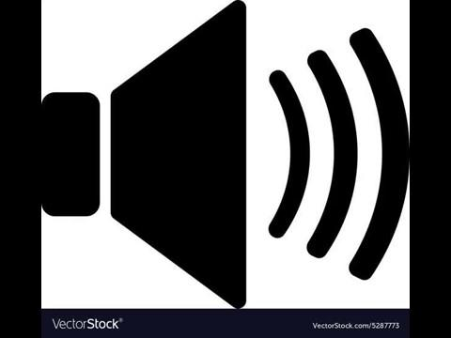
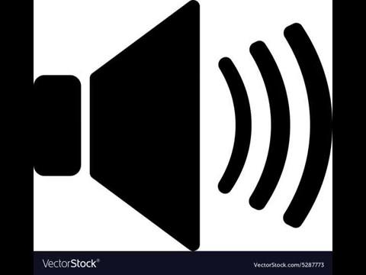
2. Bandwidth of Speech
 | 500 Hz | 1500 Hz | 2500 Hz | 4000 Hz
Man
Woman

Slide 3
2. Bandwidth of Speech
[2.1] Determine cut-off frequency for recognising speech? fc = 2500 Hz
[2.2] Determine cut-off frequency for overall degradation? fc = 1000 Hz
[2.3] Why sampling frequency of 8 KHz? Frequency of 8 KHz were used because human speech is almost perfectly recognisable at the frequency of 4 KHz.

Slide 4
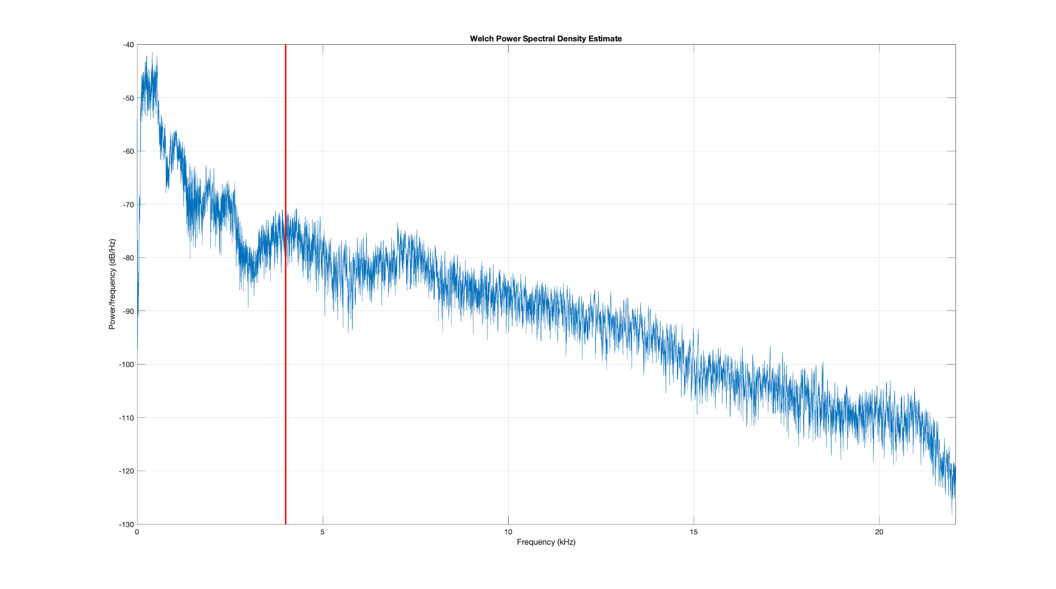
2. Bandwidth of Speech
Notes:
To show that above 4kHz we have no power in the voice so it's useless to code frequency from 4kHz to 20 kHz

Slide 5
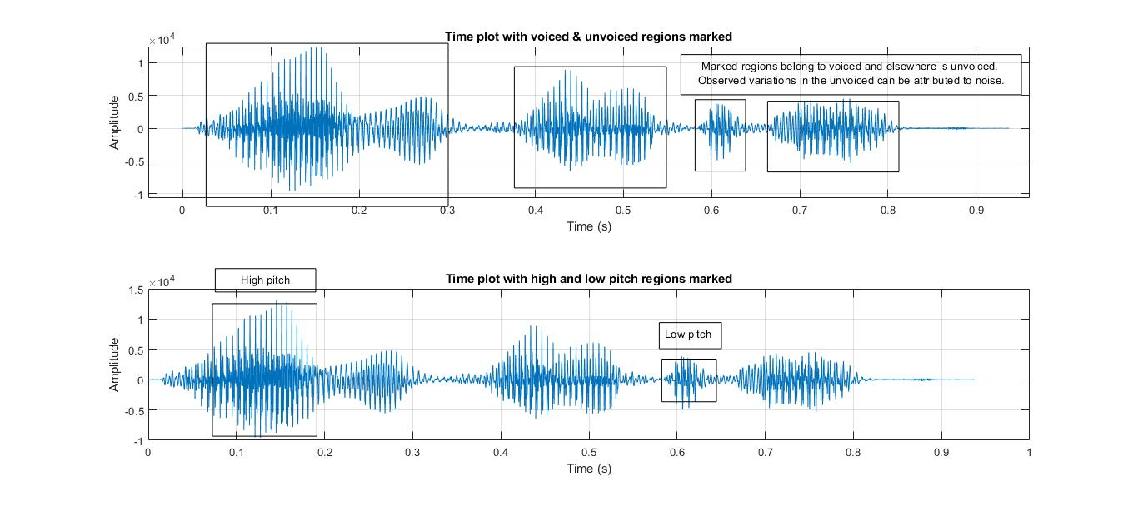
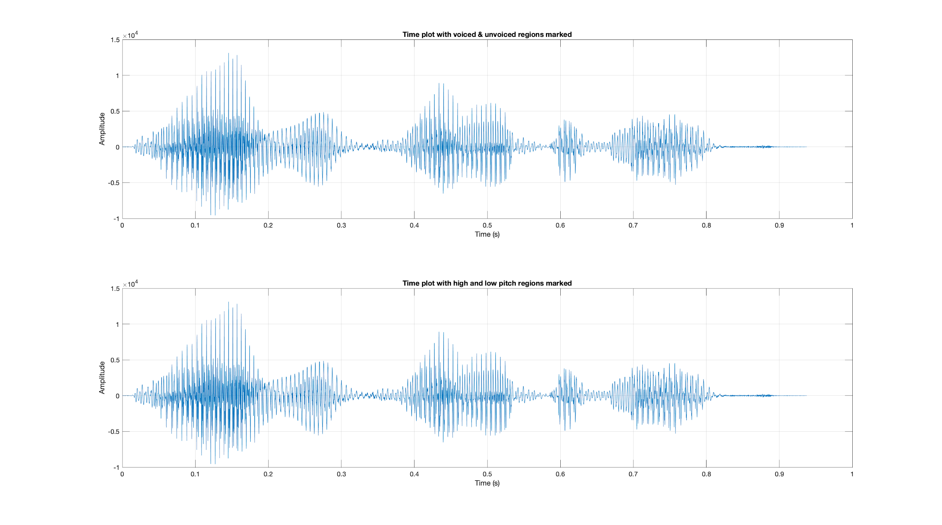
3. Voiced and Unvoiced Speech Sounds
[3.1]
[3.2]
[3.2] What are the pitch frequencies in those regions? Freq high = 700Hz ; Freq low = 450Hz;

Slide 6
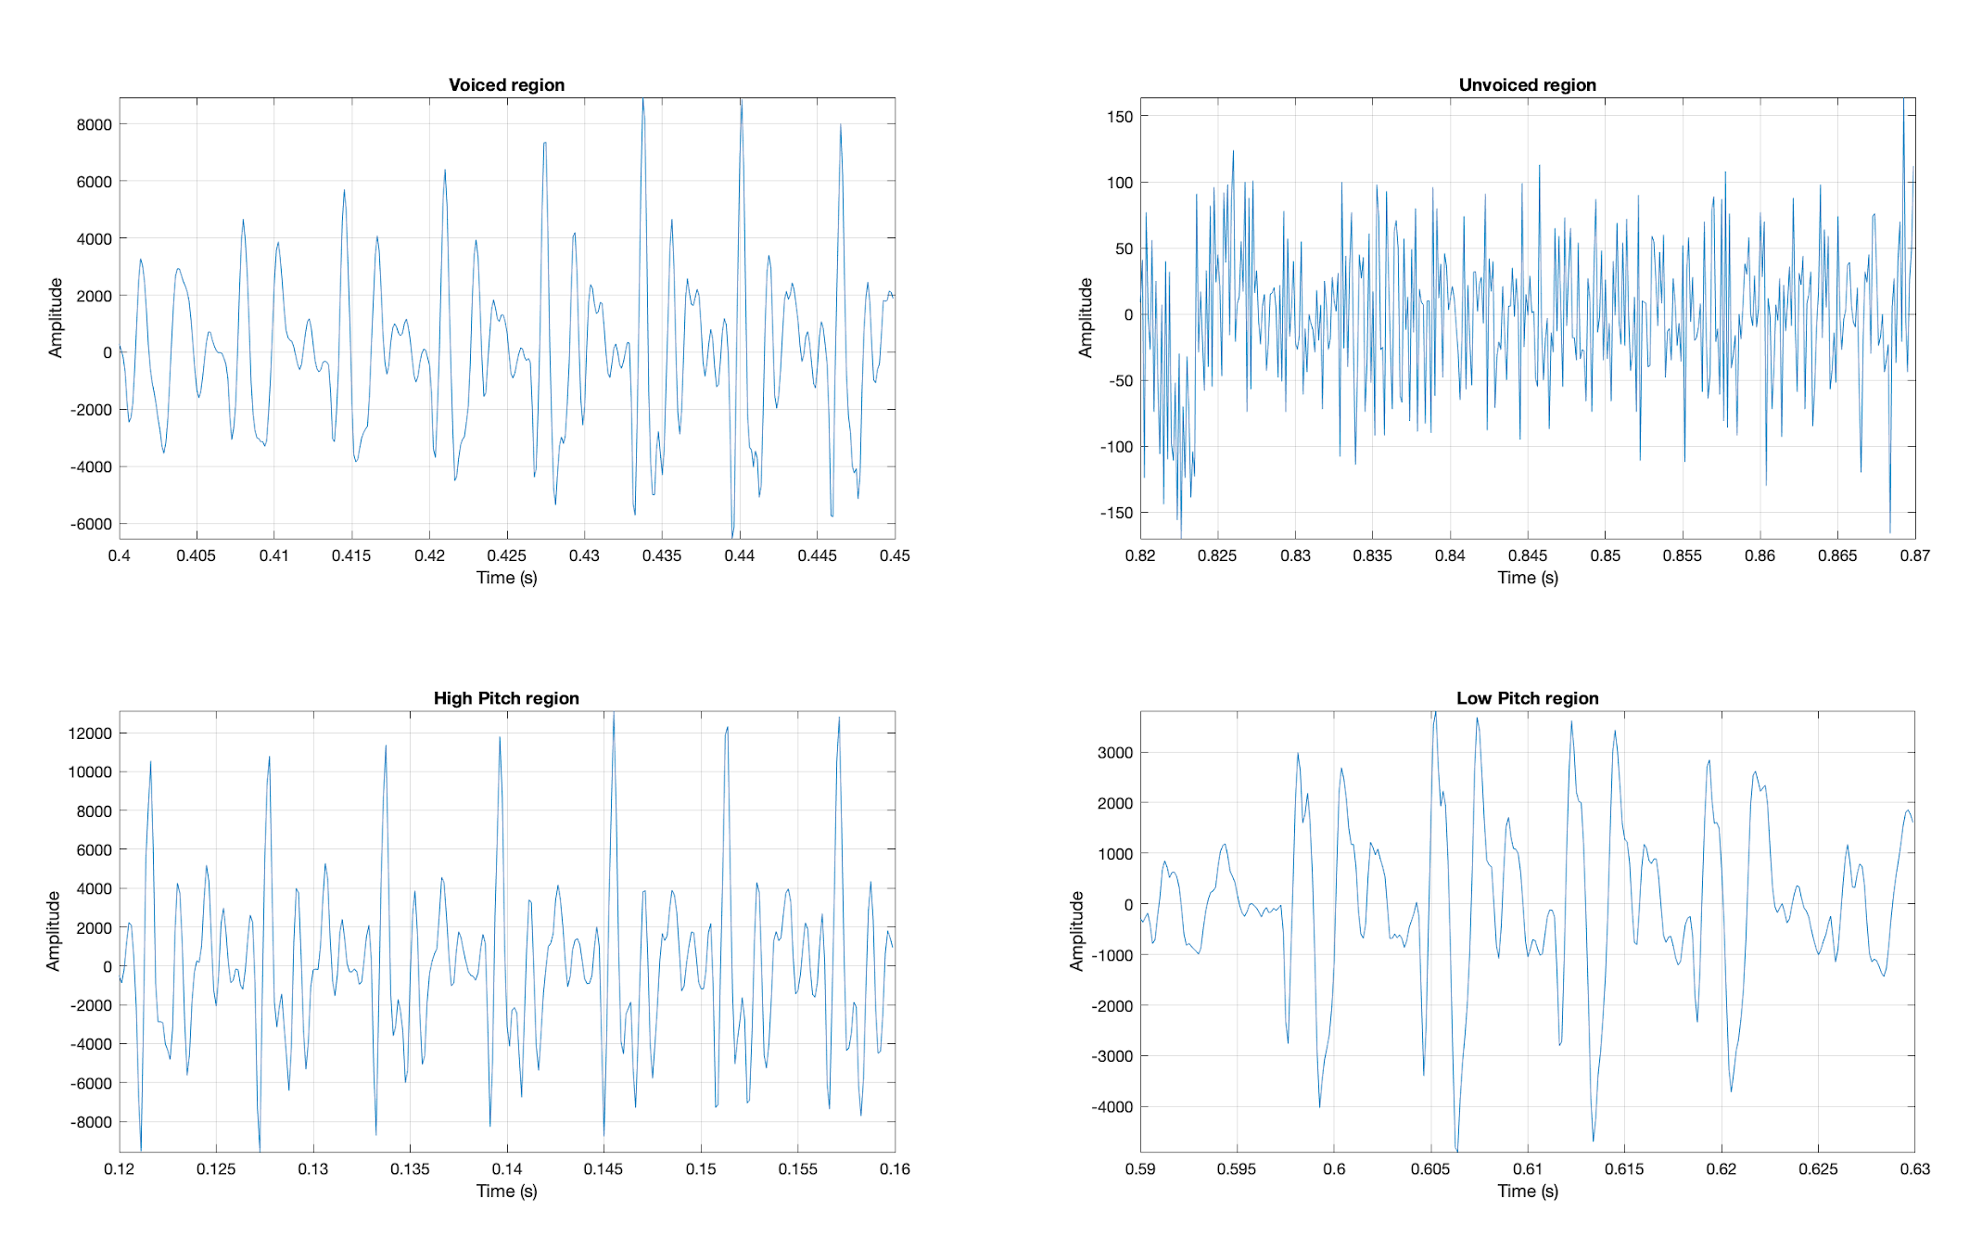
3. Voiced and Unvoiced Speech Sounds
Notes:
How can we make a difference between unvoice frame and voice frame.

Slide 7
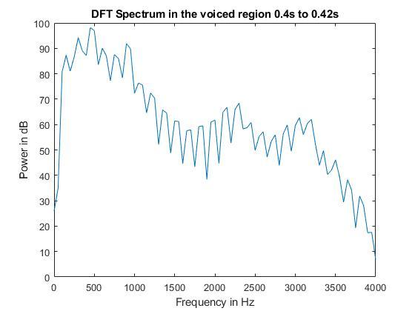
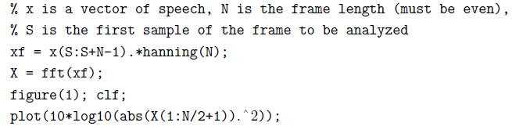
3. Voiced and Unvoiced Speech Sounds
[3.3] Power spectral density of a voiced region

Slide 8

3 Voiced and Unvoiced Speech Sounds
[3.4] Mathematic expression for X(3)
It corresponds to frequency Fs*(3-1)/N Hertz. In our example X(3) = 100 Hz
[3.5] Fundamental frequency = 500 Hertz
[3.6] A frame length about 20ms seems to be a good compromise between frequency resolution and signal stationarity.
Notes:
When we use a small frame length we loose on frequency resoltion. If we use a large frame we cannot use the fact that the signal is stationary, indeed in a speech signal the statistic of a signal depend on the time. So we have to choose a frame length that allow us to have a good resolution and to "keep" the signal stationary.

Slide 9
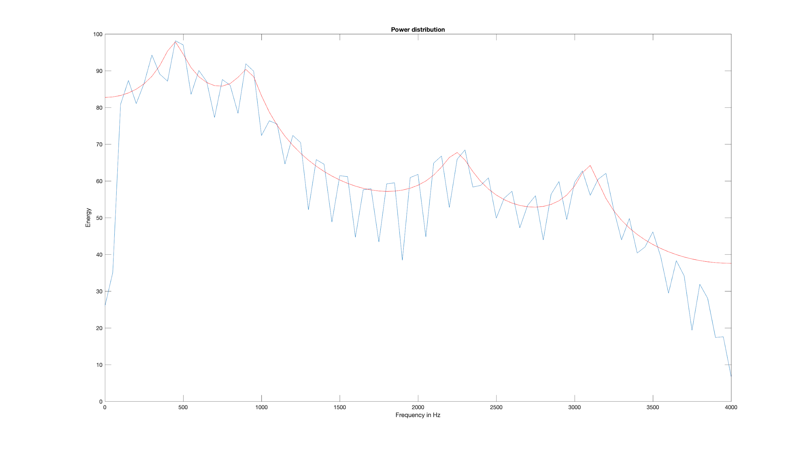
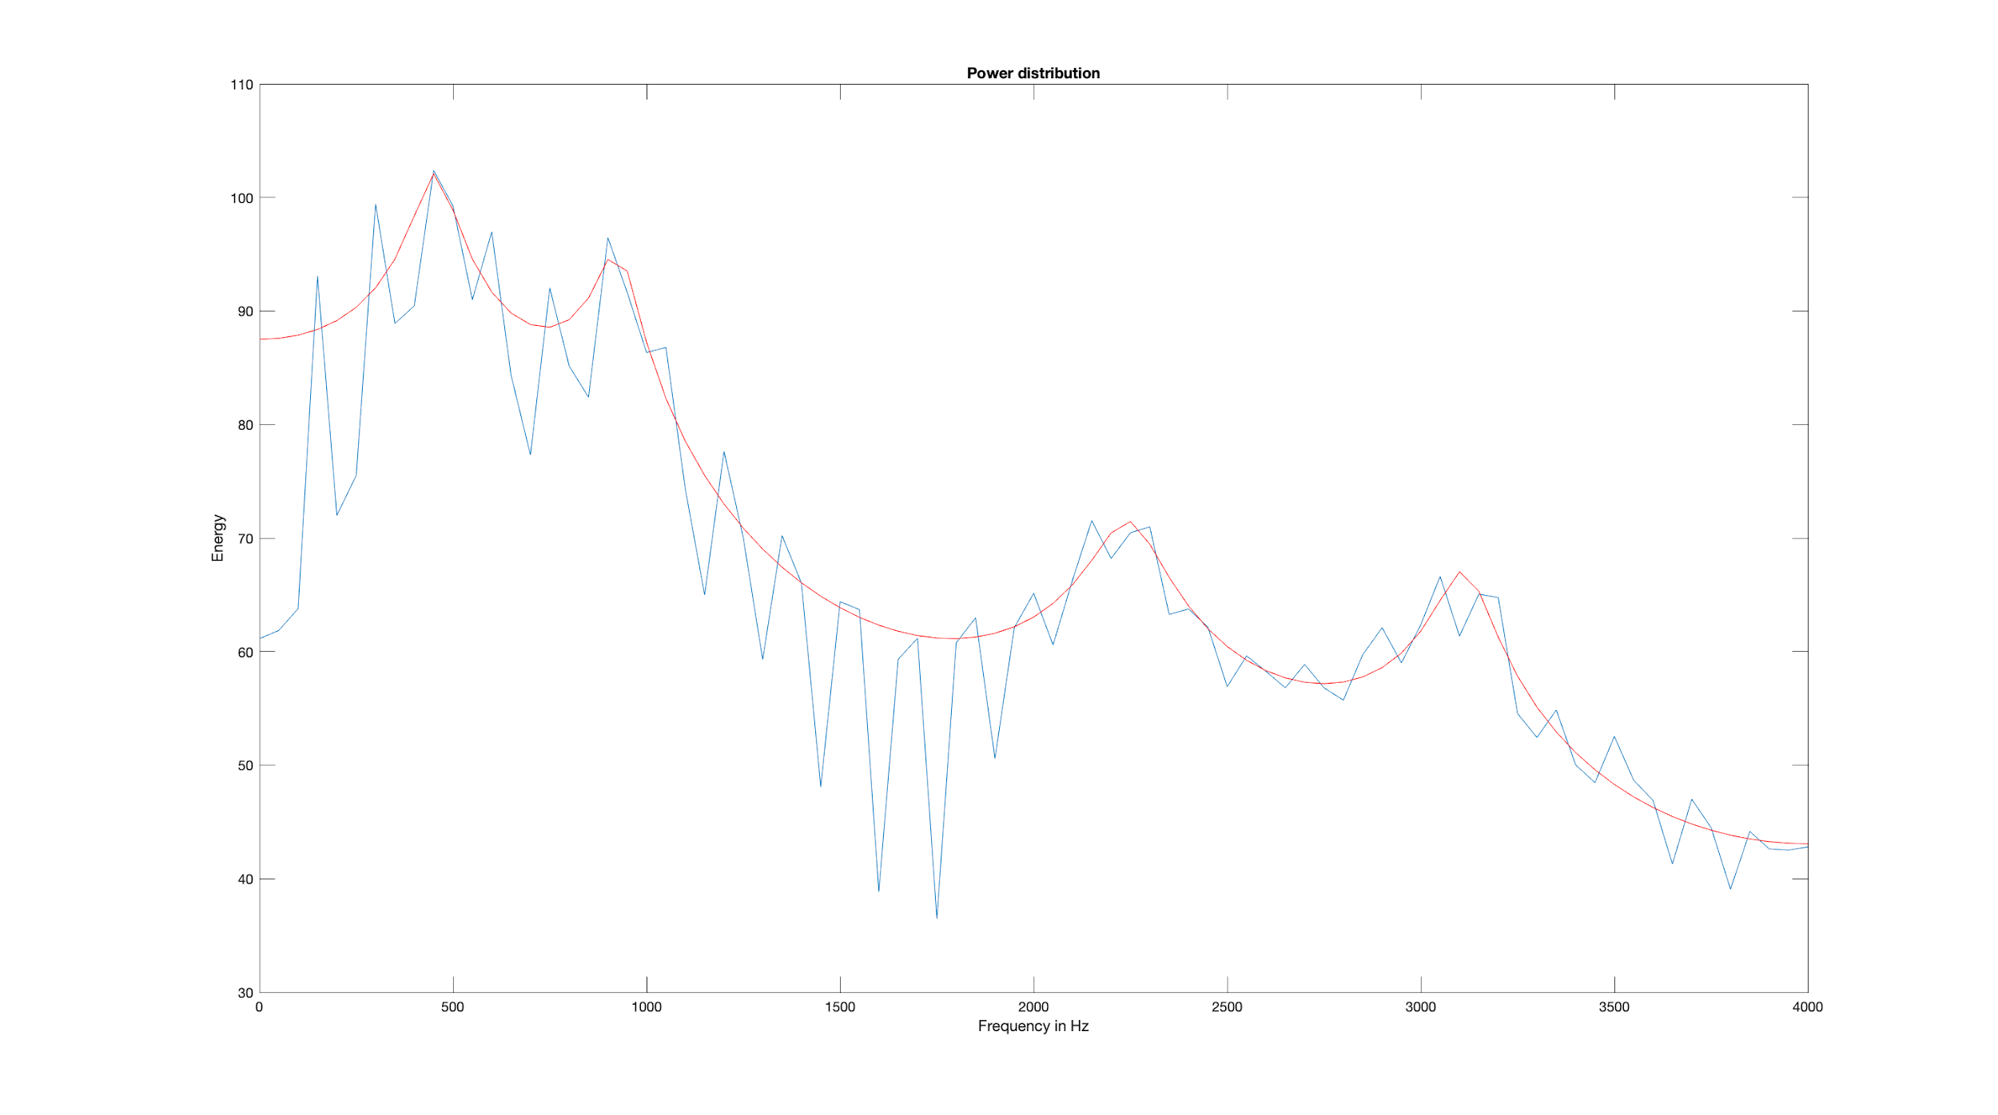
3 Voiced and Unvoiced Speech Sounds
[3.7] Hanning window vs Rectangular window: In rectangular window based PSD, we observe better frequency resolution but with high variance. Thus, the choice depends on application.
PSD-LP with an hanning window
PSD-LP with an rectangular window
Notes:
In rectangular window method, we see that with a we have a better frequency resolution but we also have a big variance. The choice of the window depend on the application and we have to make a compromise between resolution and variance.

Slide 10
3 Voiced and Unvoiced Speech Sounds
[3.8] PSD-LP using an AR model
PSD-LP with an hanning window
PSD-LP with an rectangular window

Slide 11

3 Voiced and Unvoiced Speech Sounds
[3.9] Mathematic expression
we multiply abs(h(1:N/2+1)) by e because the AR process is derived from a white noise of power e.
[3.10] By observing the power spectrum estimate we can see that there is 4 peaks, thus we can model by an AR-8 model (8 conjugate poles). We choose M = 10 to include all type of voice of people.
Notes:
When we use a small frame length we loose on frequency resoltion. If we use a large frame we cannot use the fact that the signal is stationary, indeed in a speech signal the statistic of a signal depend on the time. So we have to choose a frame length that allow us to have a good resolution and to "keep" the signal stationary.

Slide 12
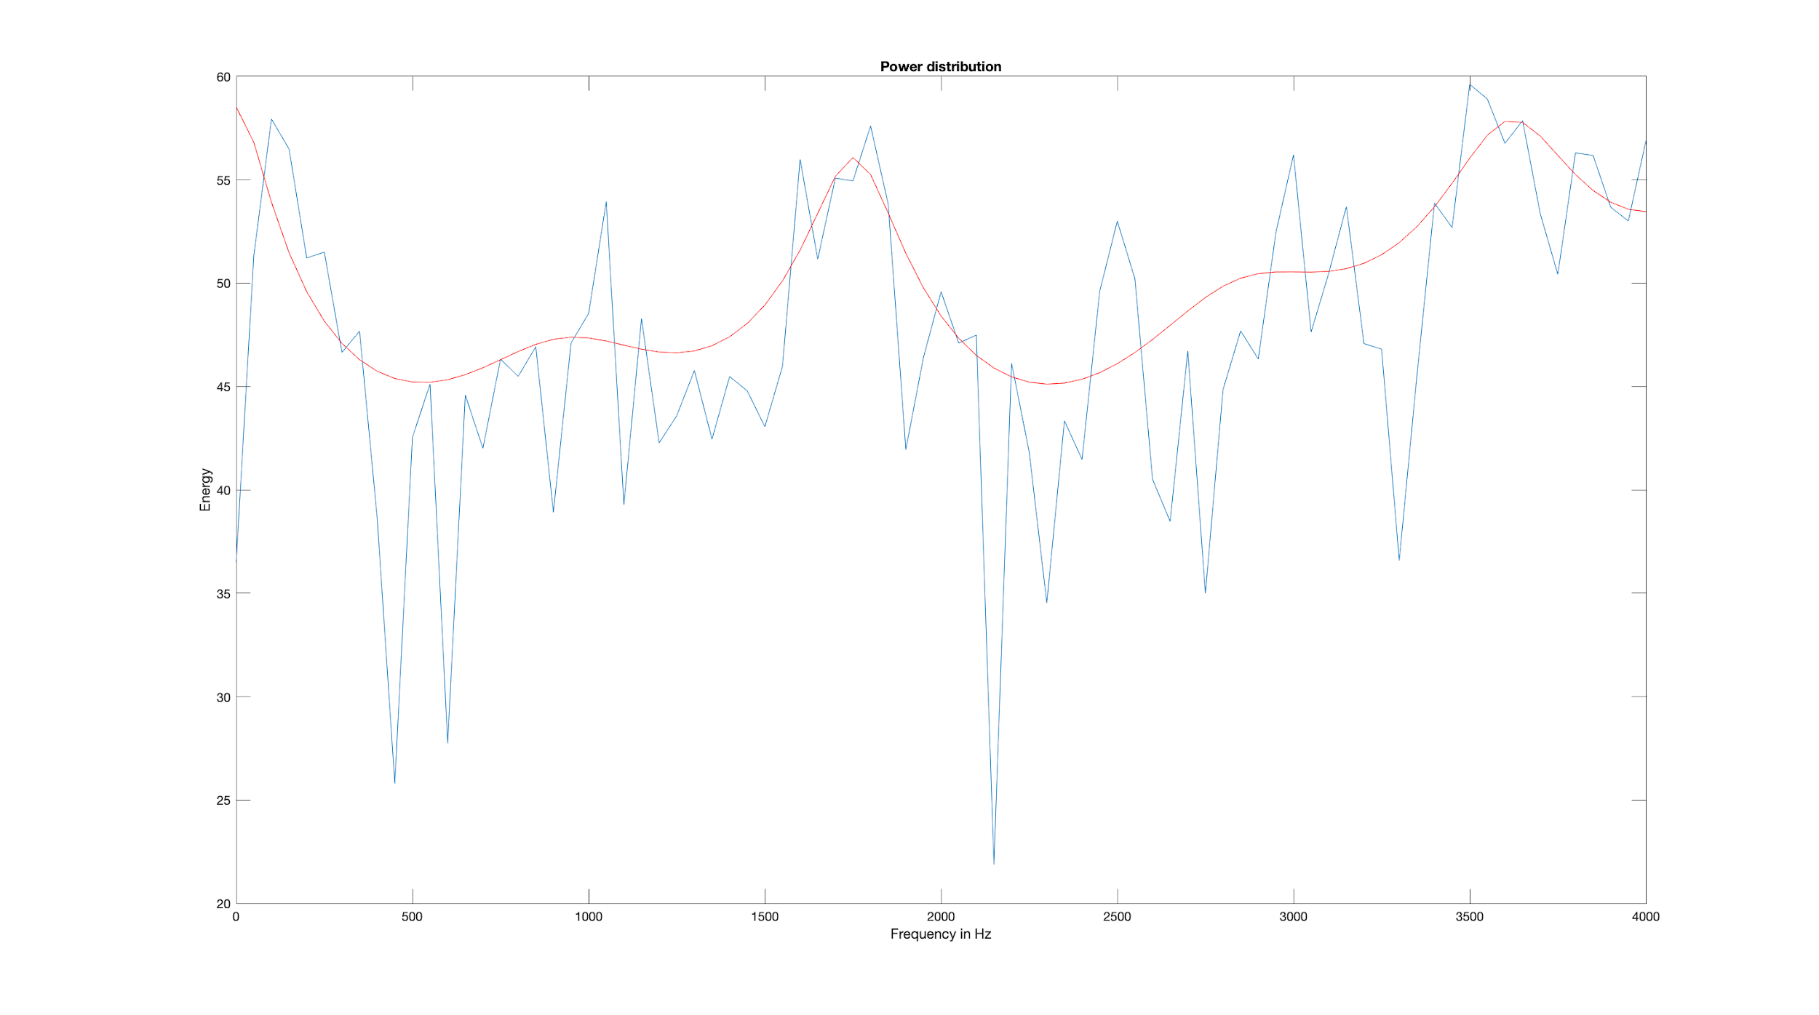
3 Voiced and Unvoiced Speech Sounds
[3.11] PSD of unvoiced region [0.82 to 0.84 sec]

Slide 13
4 Formants
[4.1] From the voiced sound plot, F1 = 450Hz, F2 = 900Hz, F3 = 2250Hz; corresponds to the vowel "uh"
[4.2] Formant frequency: Resonance frequencies.
Pitch frequency: Fundamental frequency of vibration of the vocal folds

Slide 14
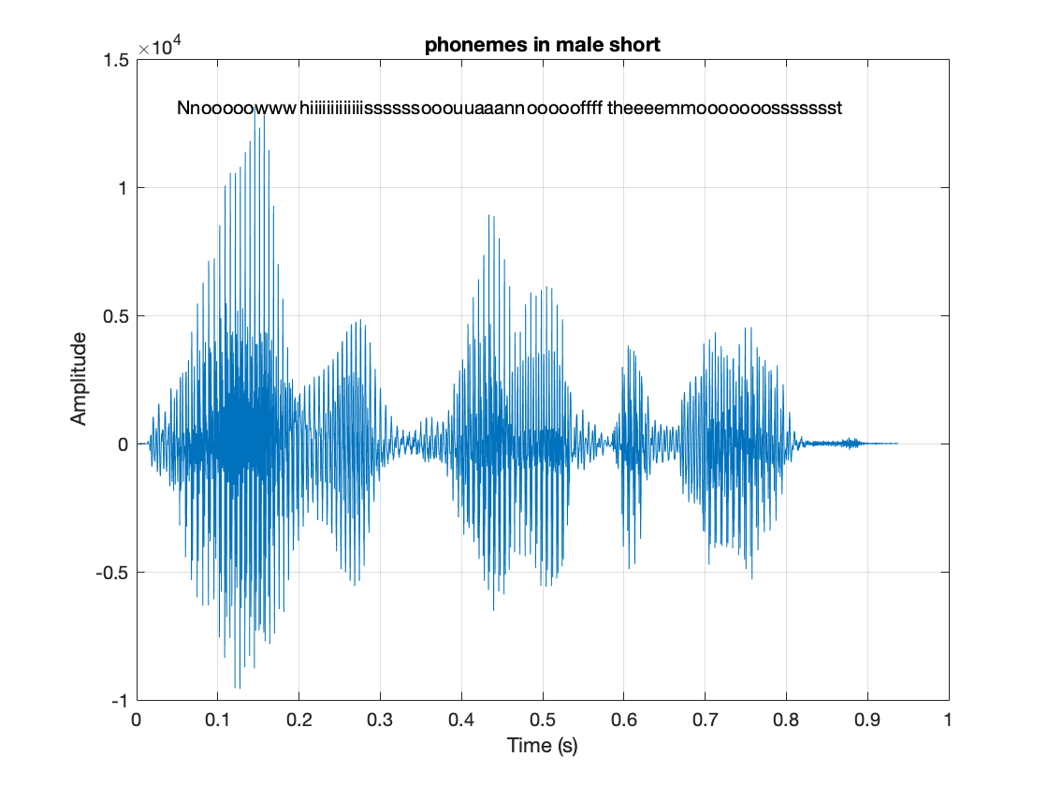
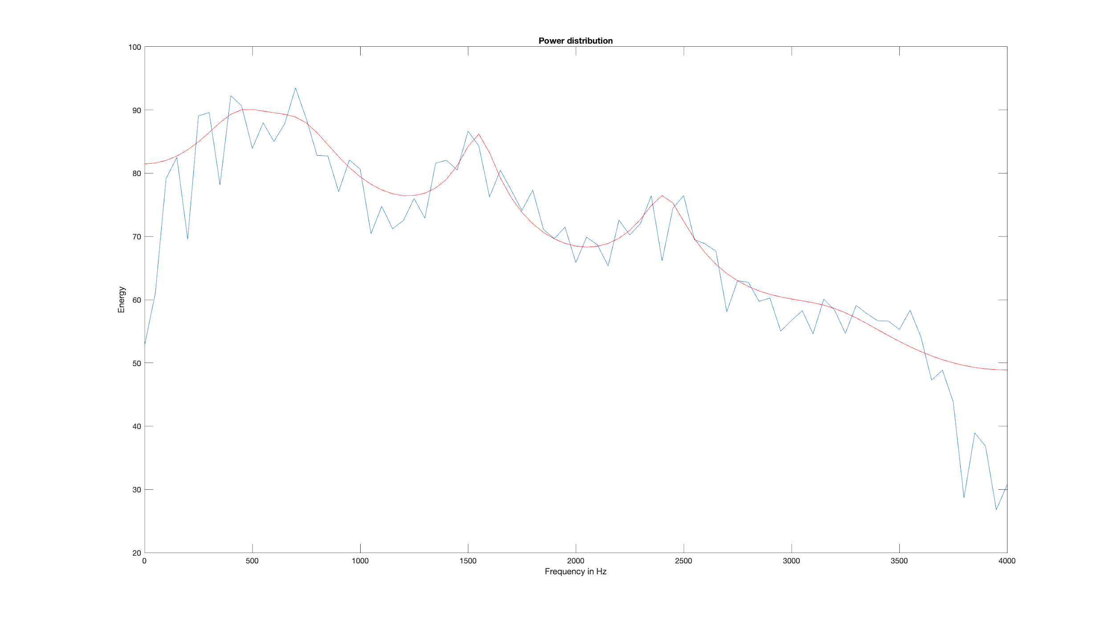
5 Phonemes and Allophones
[5.1] Phonemes and its phonetic symbol
PSD of the consonant "n"
Phonemes and allophones

Slide 15
5 Phonemes and Allophones
[5.2] Consonants can be voice sound (b, g, p, m, ...) & can have formant frequency.
[5.3] A diphthong is a sound formed by the combination of two vowels in a single syllable, in which the sound begins as one vowel and moves towards another (as in coin, loud, and side ).
[5.4] There are 44 phonemes in English
[5.5] Phone: Any distinct speech sound or gesture, regardless of whether the exact sound is critical to the meanings of words. Allophone : any of the various phonetic realizations of a phoneme in a language, which do not contribute to distinctions of meaning.
Notes:
Allophone: For example, in English an aspirated p (as in pin) and unaspirated p (as in spin) are allophones of p.

Slide 16
6 Spectrogram
[6.1] and [6.2] Spectrogram plot : myspectrogram(male_short, 256, 32); alen = 256 and ulen = 32

Slide 17
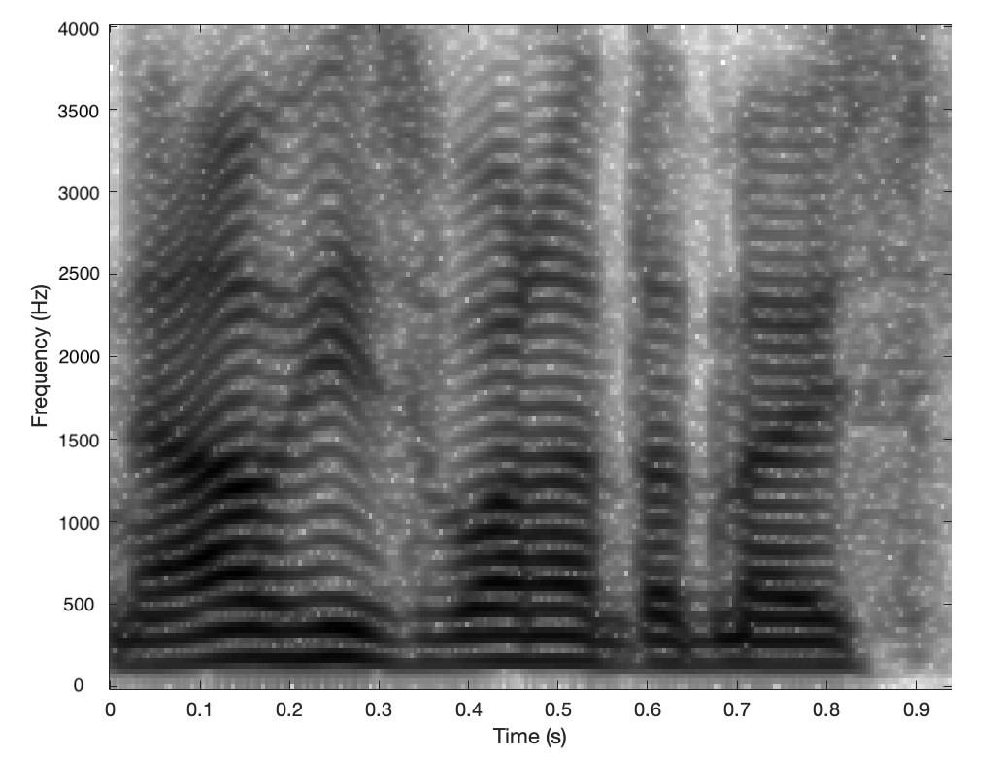
6 Spectrogram
[6.3] Spectrogram plot : myspectrogram(male_short, 256, 32); alen = 256 and ulen = 32

Slide 18
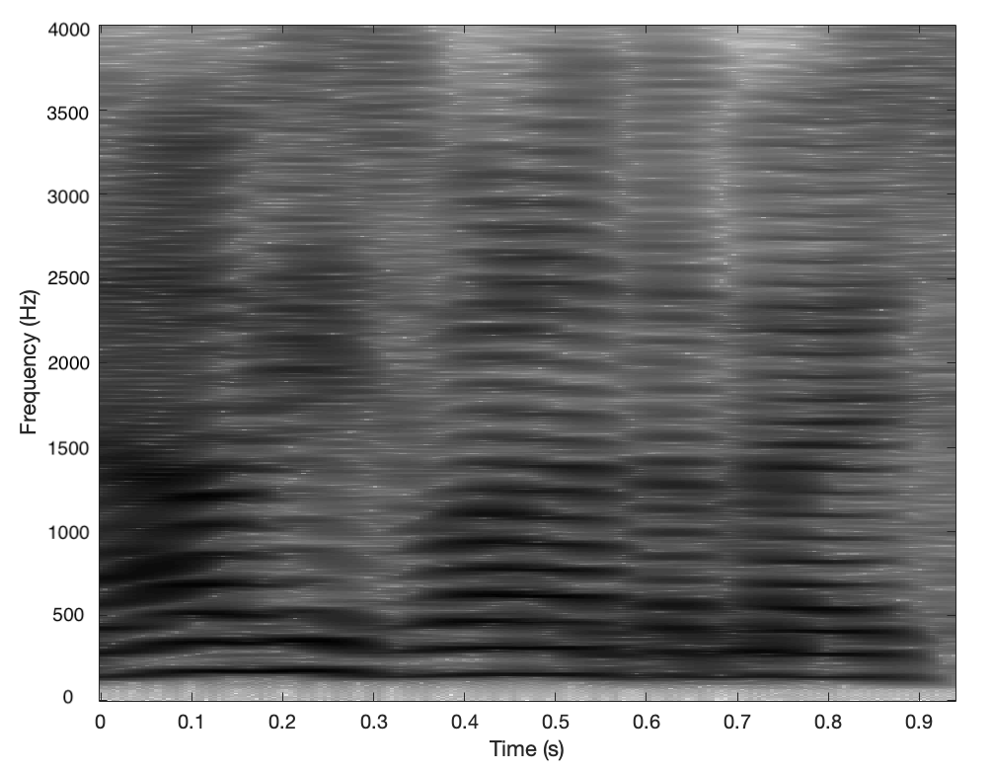
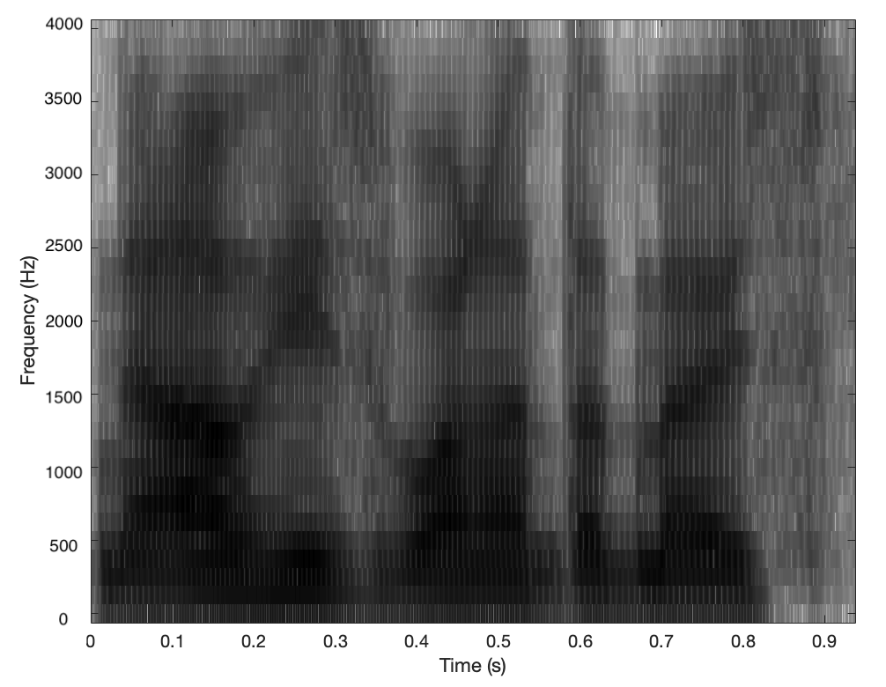
6 Spectrogram
[6.4] and [6.5] Spectrogram plot :
Narrow-band alen = 1024 and ulen = 32
Smoothed wide-band alen = 64 and ulen = 1

Slide 19
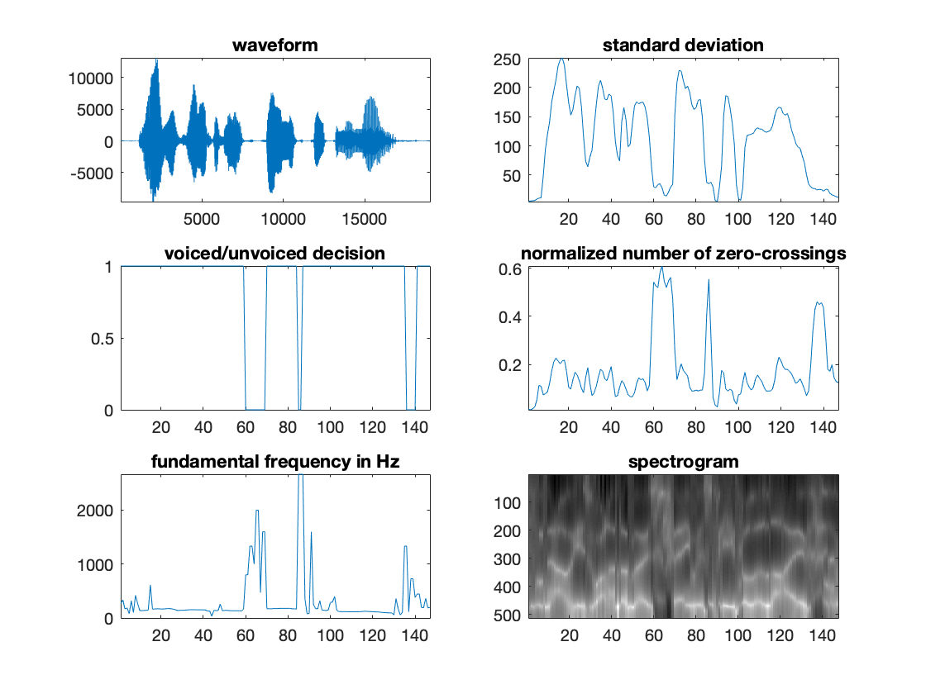
7 Speech Parameter Estimation
[7] Estimation of frame energy(E), Voiced and unvoiced classification, Vocal tract filter estimation - LP analysis, Pitch analysis,
Male_long speech with alen = 256, ulen = 128, filter order = 10

Slide 20
7 Speech Parameter Estimation
[7.6] The voice/unvoice detection can go wrong if the sound is not clear. We observe that we don't detect the silences in the voice/unvoice detection.
[7.7] A pitch doubling can be due to a harmonic interpreted as the fundamental (it can happen if the fundamental power is really low). The same interpretation can happen in the case of pitch halving.

Slide 21
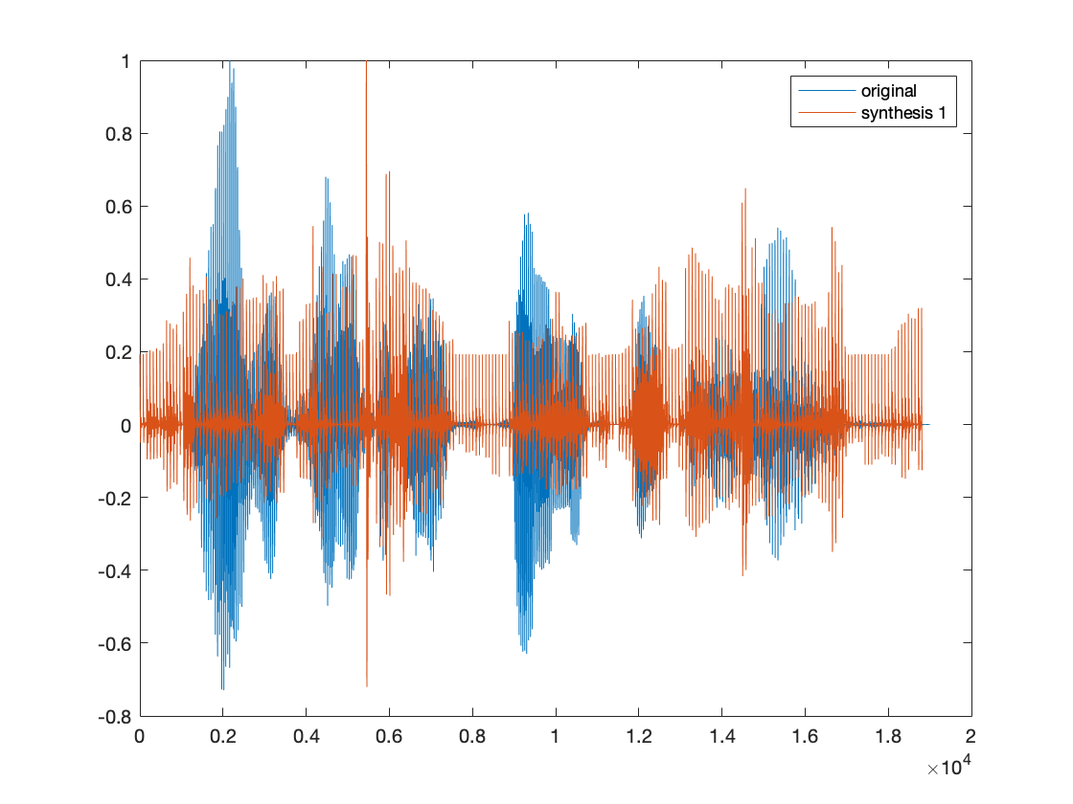
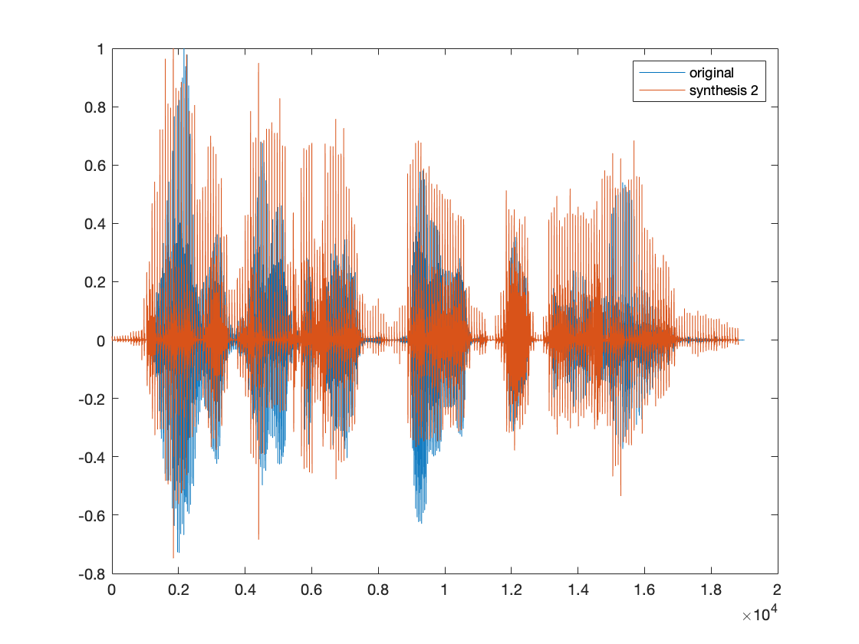
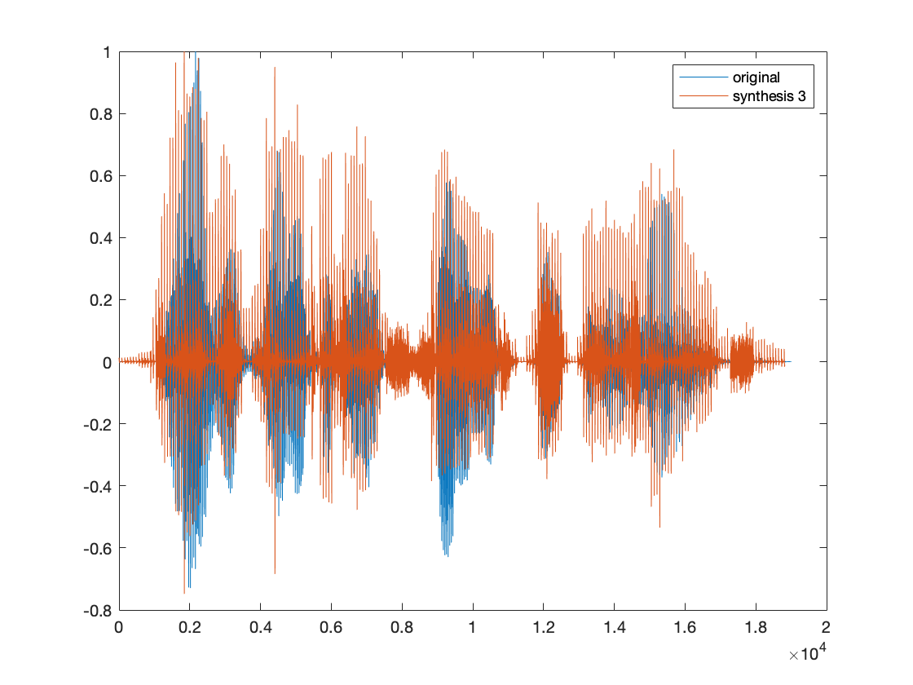
8 The Vocoder
Speech Synthesis

Slide 22
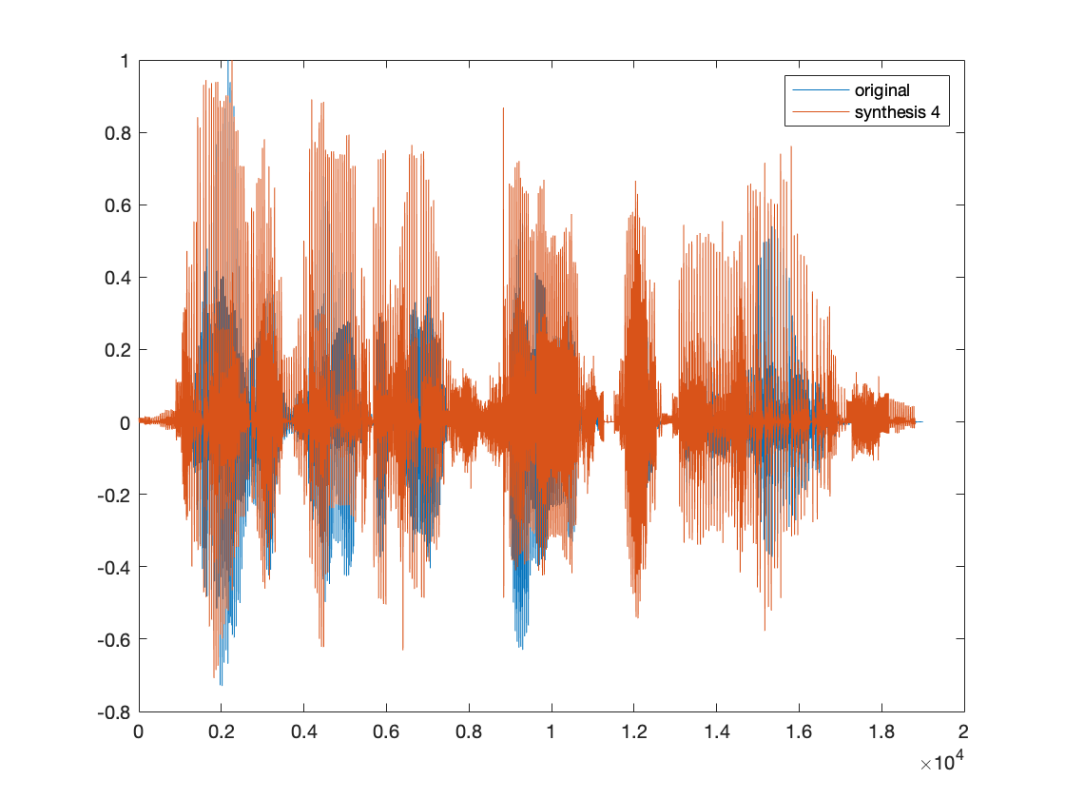
8 The Vocoder

